Slide 1
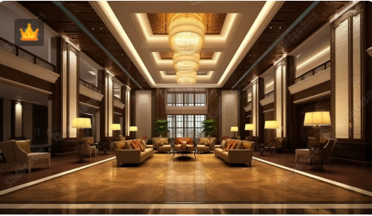
Project Title : Atlas Grand
Name : Divya Gupta

Slide 2

Business Context

Slide 3
Business Context
🏢 Client Overview
Atlas Grands is a reputed luxury hospitality brand that has been operating in the Indian market for over two decades. The group owns and manages multiple five-star hotels across prime business and tourist locations in India. Over the years, Atlas Grands has established a reputation for offering premium accommodation, business amenities, and exceptional guest experiences. However, in recent years, the company has been experiencing challenges in sustaining its dominance in the luxury/business hotels category. Despite having a strong brand legacy, growing competition from both domestic and international hotel chains, along with changes in market trends and customer preferences, has started impacting their overall performance.
📈 Business Need
Atlas Grands is determined to regain its lost market share and boost its revenue streams in the luxury/business hospitality sector. To achieve this, the leadership team has recognized the need to:
1.Leverage historical data to understand patterns in bookings, occupancy rates, seasonal demand, and customer behavior.
2.Identify revenue leakages and areas of operational inefficiency that may be impacting profitability.
3.Reassess pricing and marketing strategies to stay competitive in a market influenced by aggressive competitor strategies.

Slide 4
4.Adopt data-driven decision-making to reduce reliance on intuition and outdated methods.
The company believes that a structured approach using Business Intelligence (BI) and Data Analytics can help them make informed strategic and operational choices.
✅ Reason Behind This Survey
Due to the absence of an in-house data analytics department, Atlas Grands has decided to partner with a third-party analytics service provider to conduct a detailed analysis of their historical operational and financial data.
The objectives of this engagement are to:
1.Generate actionable insights from historical booking, revenue, and operational datasets.
2.Benchmark performance against market trends and competitors’ positioning.
3.Understand customer segments and their booking patterns to tailor offerings.
4.Forecast demand and optimize pricing strategies for different seasons and market conditions.
5.Support strategic decisions for marketing campaigns, loyalty programs, and expansion plans.

Slide 5

Problem Statement

Slide 6
Problem Statement
Atlas Grands, despite being a reputed player in the Indian luxury hospitality market, is facing a consistent decline in market share and revenue due to strong competitor strategies and ineffective decision-making.
Although the company has maintained detailed historical data across hotels, rooms, and bookings, this data is currently underutilized. Critical challenges include:
Lack of Data-Driven Decisions: Business decisions are currently driven by intuition rather than insights, leading to missed revenue opportunities.
Unoptimised Revenue Management: The absence of proper demand forecasting, room utilization tracking, and pricing optimization has impacted profitability.
Limited Understanding of Customer Behavior: Although data on booking patterns, platforms, cancellations, no-shows, and customer ratings exists, it has not been leveraged to improve customer experience or retention.
Operational Inefficiencies: Capacity utilization, booking platform effectiveness, and cancellation impacts are not analyzed systematically.
Dependence on External Analytics: Without an in-house analytics team, valuable data remains raw and untransformed into business intelligence.

Slide 7
Technology Stack & Tool Usage
Excel
to analyze data from CSV files for business insights.
SQL (Structured Query Language)
Imported and connected raw data tables
Handled data transformation, filtering, joining, and aggregation
Identified and resolved data discrepancies and inconsistencies.
Power BI Desktop
Created interactive dashboards and reports
Visualized KPIs, sales trends, product/category performance, and customer insights
Enabled user-friendly views for exploring data patterns
PowerPoint (PPT)
Documented business context, problem statement, and key findings
Presented insights, analysis outcomes, and strategic recommendations
Final deliverable.

Slide 8
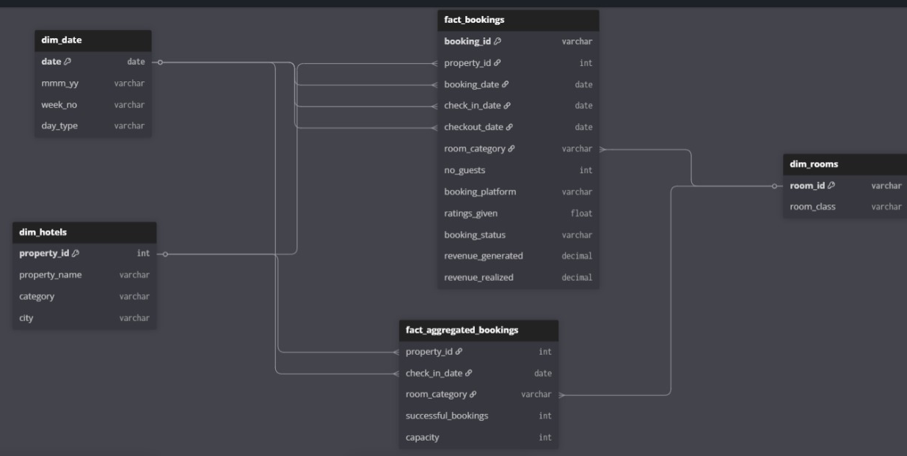
ER - Diagram

Slide 9
Relationship – Primary Key , Foreign Key
Table | Primary Key | Foreign Key
dim_date | date | -
dim_hotels | property_id | -
dim_rooms | room_id | -
fact_bookings | booking_id | property_id → dim_hotels, room_category → dim_rooms, booking_date/check_in_date/ check_out_date → dim_date
fact_aggregated_bookings | Composite Key: (property_id, check_in_date, room_category) | property_id → dim_hotels, room_category → dim_rooms, check_in_date → dim_date

Slide 10

Data Description

Slide 11
📊 Fact_Bookings
Description: Stores detailed information of each hotel booking, including property, room, dates, customer details, and realized revenue.
Key Features:
booking_id → Unique booking transaction ID.
property_id → Hotel identifier.
booking_date → Date when booking was made.
check_in_date → Date of hotel check-in.
check_out_date → Date of hotel check-out.
no_guests → Number of guests in the booking.
room_category → Room type booked (RT1–RT4).
booking_platform → Channel used to book (e.g., app, website, agent).
ratings_given → Customer’s rating for hotel services.
booking_status → Final status (Cancelled, Checked Out, No show).
revenue_generated → Gross revenue from booking.
revenue_realized → Net revenue earned after status-based adjustments.
Purpose: To capture the full lifecycle of each booking and track financial performance.
Importance: Forms the central transactional dataset for analyzing hotel occupancy, cancellations, and revenue trends.

Slide 12
📊 Dim_Date
Description: Date dimension providing calendar details for bookings and analysis.
Key Features:
date → Actual calendar date (May–July).
mmm yy → Date in “Month Year” format.
week_no → Unique week number of the date.
day_type → Identifies if the day is a Weekday or Weekend.
Purpose: Provides temporal attributes to support trend and seasonal analysis.
Importance: Essential for time-series reporting (daily, weekly, monthly performance).
📊 Dim_Rooms
Description: Master data of room categories available in hotels.
Key Features:
Room_id : Room type code (RT1–RT4).
Room_category : Type of room (Premium, Elite, Standard, Presidential).
Purpose: Helps classify bookings and analyze performance at room-type level.
Importance: Critical for demand forecasting, pricing strategy, and occupancy planning.

Slide 13
📊 Fact_Aggregated_Bookings
Description: Aggregated daily booking summary per property and room category for faster reporting.
Key Features:
property_id → Hotel identifier.
check_in_date → Customer check-in date.
room_category → Room type booked (RT1–RT4).
successful_bookings → Number of confirmed bookings for the room.
capacity → Total available rooms of that type on that date.
Purpose: To provide a summarized view of hotel performance, reducing query complexity.
Importance: Helps in quick KPI tracking (occupancy, cancellations, revenue) at property and room level.
📊 Dim_Hotels
Description: Master data of hotels/properties managed by the company.
Key Features:
Property_id :Unique hotel identifier..
Property_name, City, Category :Name of the hotel, Hotel class (Luxury/Business), City where the hotel is located.
Purpose: Acts as reference table to link bookings with property details.
Importance: Enables property-level analysis of revenue, occupancy, and customer behavior

Slide 14

Data discrepancies /Data Inconsistencies identified using SQL

Slide 15
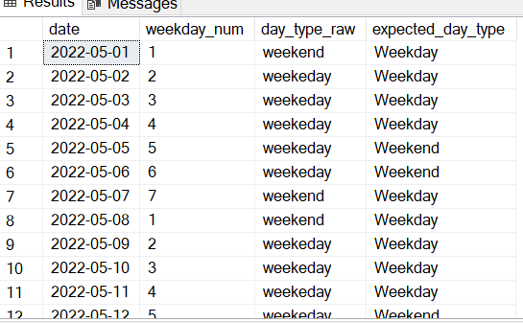
Incorrect Day Type in dim_date:
Issue: Some dates in dim_date had the wrong day_type (Weekend/Weekday) assigned.
How I Cleaned it:
1.Computed correct weekday index using SQL (DATEPART with DATEFIRST).
2.Mapped:
Weekend -> Friday, Saturday(5,6)
Weekday -> All other days
3.Created a cleaned table dim_date_cleaned with correct labels.

Slide 16
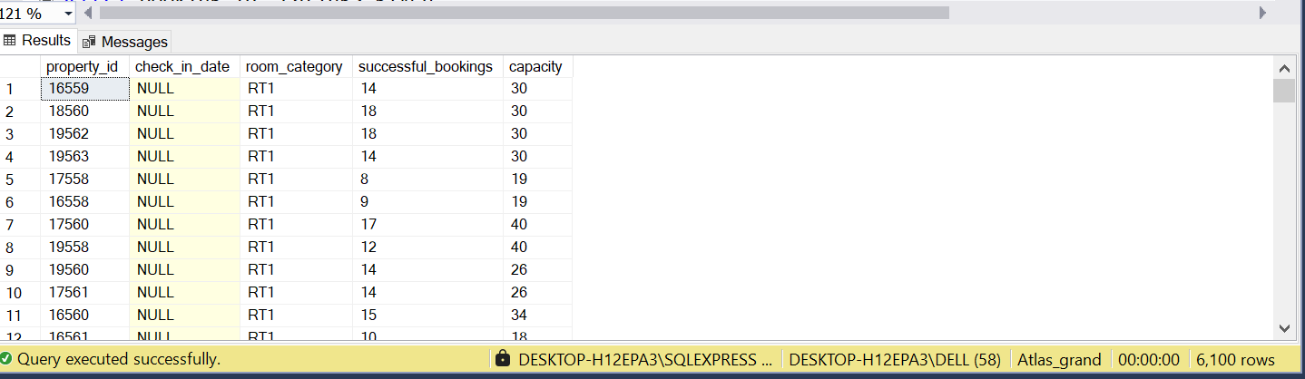
2. check_in_date Missing in fact_aggregated_booking :
Issue: Some rows in fact_aggregated_bookings had check_in_date = NULL. This caused mismatches with dim_date and made time-based
reporting (like occupancy trends, capacity utilization, and booking success rate) inconsistent.
How I Cleaned it:
Some rows in fact_aggregated_bookings had missing check_in_date, traced back to incomplete records in fact_bookings. To fix this, the table was rebuilt by excluding null dates and regrouping by property_id, room_category, and check_in_date, with recalculated metrics (successful_bookings = Checked Out, capacity = total guests). The cleaned dataset (fact_aggregated_bookings_cleaned) now has valid dates aligned with dim_date for accurate time-based analysis.

Slide 17
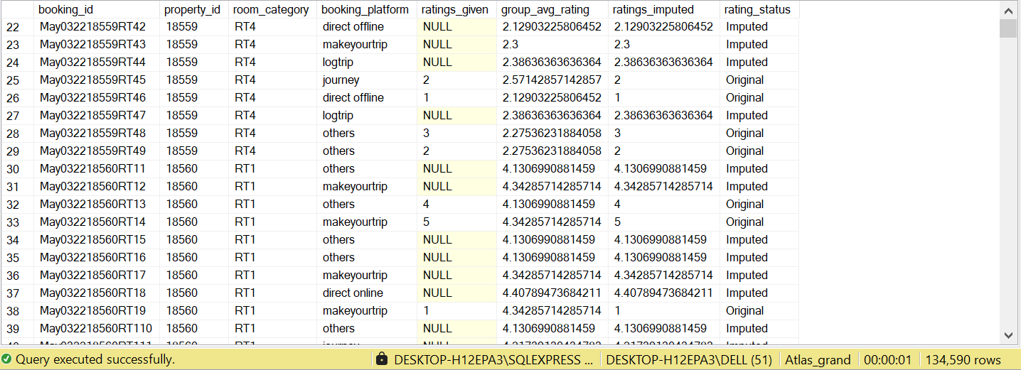
4. NULL ratings_given:
Issue: Many bookings had ratings_given = NULL, especially for Checked Out stays.
How I Cleaned it:
Calculated group-level averages by (property_id, room_category, booking_platform).
Replaced NULL ratings with the group’s average.
Updated fact_bookings_cleaned in place.

Slide 18
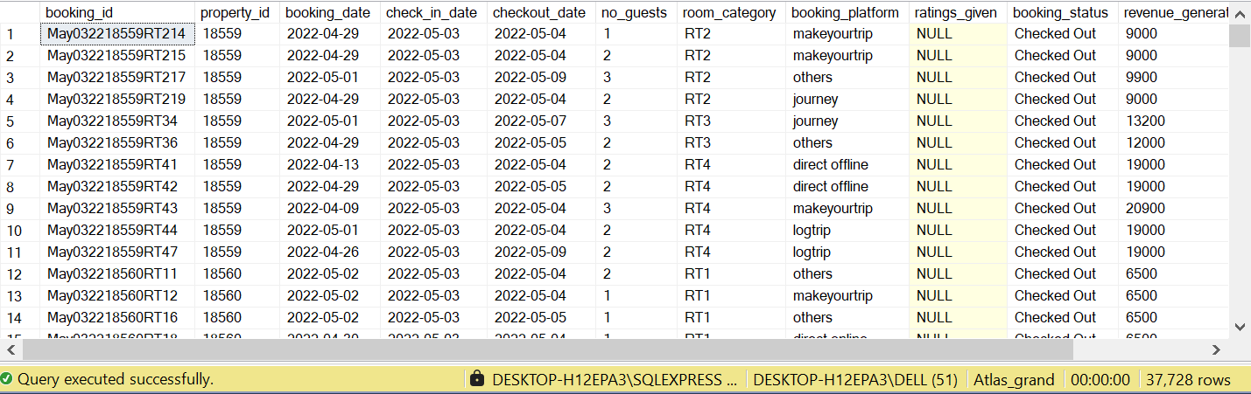
5. Missing Ratings for Checked-Out Bookings
Issue:
Business rule: If a guest has “Checked Out”, they should have provided a rating.
However, 37,728 rows had booking_status = 'Checked Out' but ratings_given = NULL.
This inconsistency impacts customer satisfaction analysis and rating-based performance metrics.
How I Solved it:
Identified all such rows with missing ratings.
Grouped data by property_id, room_category, and booking_platform.
Calculated average ratings within each group.
Imputed missing values with the group’s average rating.
Added a new column ratings_imputed for transparency (so original + imputed can be compared).

Slide 19

List Of Output to Generate

Slide 20
1.Descriptive Analytics (What happened?)
Purpose: Summarize past performance with clear metrics.
Possible Questions:
What was the total revenue generated last month, by property and city?
What was the average occupancy % (weekdays vs weekends)?
Which room categories (RT1–RT4) had the highest booking share?
What was the ADR (Average Daily Rate) by property category (Luxury vs Business)?
How many bookings came from each platform (Online Travel Agency (OTA) vs direct vs walk-in)?
What was the average rating given per hotel and room type?
Which city generated the highest revenue per available room (RevPAR) during the analysis period?
What was the cancellation % overall and by room category?
How many no-show bookings occurred, and how much revenue was lost?
What was the week over week (WoW) change in revenue, occupancy, ADR, and RevPAR?
Use case: Provides management a snapshot of how the business is performing in terms of occupancy, revenue, and customer satisfaction.
2.Diagnostic Analytics (Why did it happen?)
Purpose: Investigate reasons behind observed patterns.
Possible Questions:
Why did occupancy % drop in some properties despite high capacity?
Which booking platforms have the highest cancellation rates and why?
Why is revenue realization % lower in some hotels (e.g., higher cancellations or no-shows)?
Why do weekend bookings outperform weekdays in some cities but not others?

Slide 21
Why are premium rooms under-booked compared to standard rooms?
Why are ratings lower in some hotels — is it linked to property category, room class, or location?
Why did RevPAR decline WoW despite stable occupancy?
Which hotels are over-reliant on Online travel agency (OTAs) instead of direct bookings?
Why do some cities show high guest count per booking compared to others?
Why does Average daily rate fluctuate more in one city compared to another?
Use case: Helps pinpoint root causes of underperformance so management can take corrective actions.
3. Predictive Analytics (What will happen?)
Purpose: Use historical trends to forecast future outcomes.
Possible Questions:
What will be the occupancy % next week/month for each property?
How much revenue is expected during peak weekends?
Which booking sources are likely to generate higher cancellations in the coming weeks?
What is the probability of no-show bookings by customer profile/platform?
Which cities are expected to see higher demand in the next quarter?
What will be the expected ADR trend during festive or holiday seasons?
Which room categories are likely to be most in demand in upcoming weeks?
How will customer ratings trend based on historical performance?
What is the forecasted RevPAR growth for each property category?
How much capacity utilization can we expect for luxury vs business hotels?
Use case: Supports resource planning, staffing, and inventory optimization by anticipating demand and cancellations.

Slide 22
4.Prescriptive Analytics (What should we do?)
Purpose: Recommend best actions for optimal outcomes.
Possible Questions:
What dynamic pricing strategy should we apply to maximize ADR during peak demand?
Which properties should get discount campaigns to boost occupancy in low-demand periods?
Should we reallocate rooms between categories (e.g., convert underutilized Premium rooms into Standard)?
Which booking platforms should we promote more to reduce cancellations?
What loyalty offers should we design to reduce no-shows and cancellations?
How should we optimize staffing based on predicted occupancy levels?
Which hotels need service quality improvements based on low ratings?
Should we increase direct booking incentives to reduce dependence on OTAs?
Which properties need localized promotions (e.g., in cities with declining demand)?
How should we bundle services (e.g., room + meal plans) to increase revenue realization?
Use case: Guides strategic decisions that improve profitability, occupancy, and customer experience.

Slide 23

Exploratory Data Analysis

Slide 24
Metrics
1.Total Revenue: 1.71 Billion
2.Total Booking : 134.6K
3.Total Capacity : 274.1K
4.Total Successful booking : 94K
5.Occupancy % : 34.43%
6.Average Rating : 3.62
7.Total Cancelled :33K
8.Cancellation % : 24.83%
9.Total Checked Out : 94K
10.Total no show booking : 6.8K
11.No Show Rate %: 5.02%
12.Overall Average Daily Rate:18.1K
13.Revenue per Available Room : 418.95

Slide 25
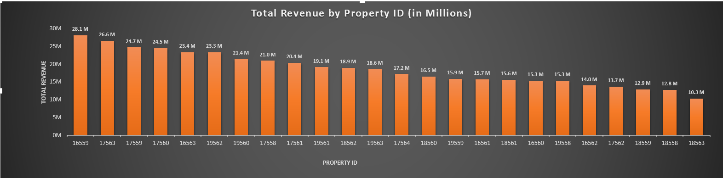
1.Revenue Contribution by Property
Insight → A few properties (16559, 17563, 17559) contribute the majority of revenue, while several properties (16558,
18563, 18558) generate significantly lower revenue, showing uneven performance.
Recommendation → Replicate success factors from top-performing properties, implement targeted marketing and dynamic pricing
for weaker hotels, and reduce dependency on a few properties by boosting underperformers.

Slide 26
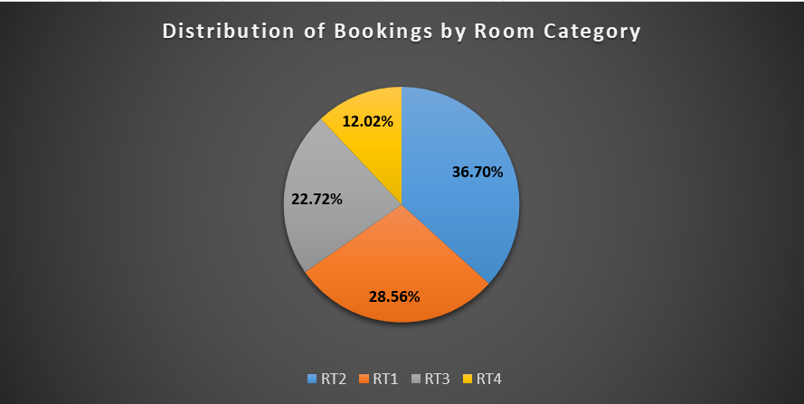
2.Distribution of Bookings by Room Category
Insight → RT2 has the highest share (~37%), followed by RT1 (~29%), while RT4 contributes the least (~12%). This shows customer preference is skewed toward RT1 & RT2.
Recommendation → Focus on promoting and upselling RT2/RT1 to maximize revenue, while redesigning or repositioning RT4 (e.g., better pricing, offers) to improve its demand share.

Slide 27
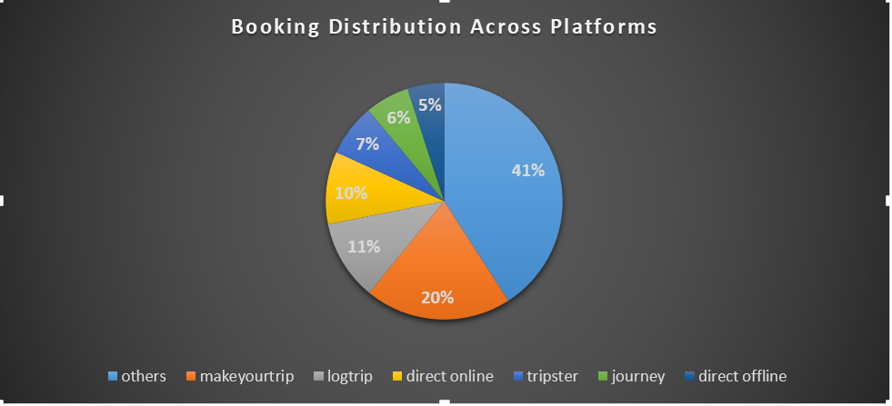
3.Booking Distribution Across Platforms
Insight → The majority of bookings come from OTAs (e.g., Makeyourtrip, Logtrip, Tripster, Journey), with “Others”
being the largest share. Direct channels (online & offline) contribute relatively less. This shows high dependency on
third-party platforms.
Recommendation → Strengthen direct booking channels (website, app, loyalty programs) to reduce commission
costs and dependency on OTAs, while maintaining partnerships with top OTAs for wider reach.

Slide 28
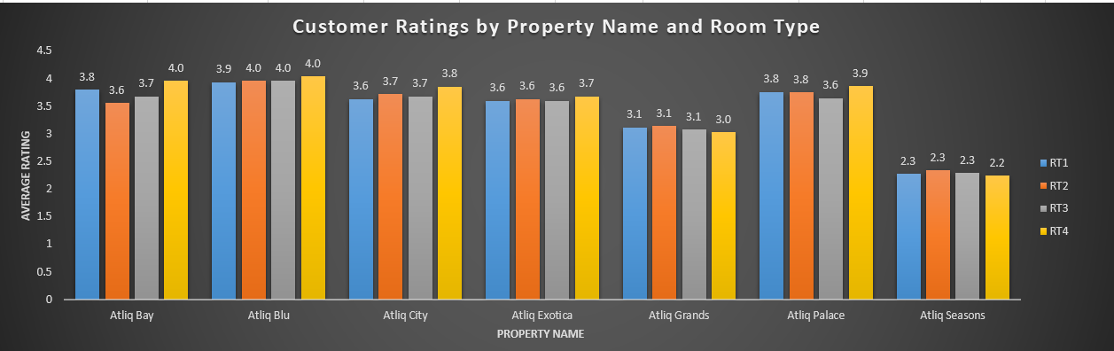
4.Customer Ratings by Property & Room Category
Insight → Properties like Atliq Blu and Atliq Palace consistently have higher ratings (~3.9–4.0), while Atliq Grands
and especially Atliq Seasons show much lower ratings (~2.2–3.1). Room categories don’t vary much within the same
property, meaning service quality at property level is the main driver.
Recommendation → Focus on improving guest experience at Atliq Grands and Atliq Seasons through staff training,service quality enhancement, and facility upgrades. At the same time, maintain high standards at Atliq Blu and Atliq Palace to retain customer loyalty.

Slide 29
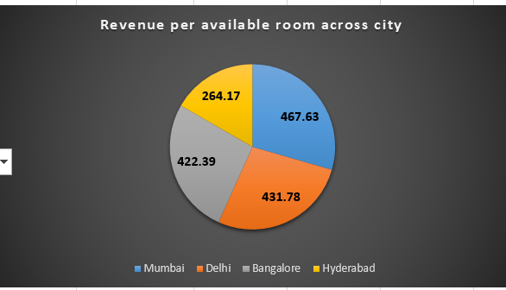
5.Revenue per available room across city
Insight → Mumbai has the highest RevPAR (~495), followed by Delhi (~457) and Bangalore (~447), indicating stronger revenue efficiency in metro cities. Hyderabad lags significantly (~279), showing weaker market performance.
Recommendation → Strengthen pricing strategies, marketing, and partnerships in Hyderabad to boost demand and occupancy. Continue leveraging strong demand in Mumbai, Delhi, and Bangalore with premium pricing and loyalty programs to maximize profitability.

Slide 30
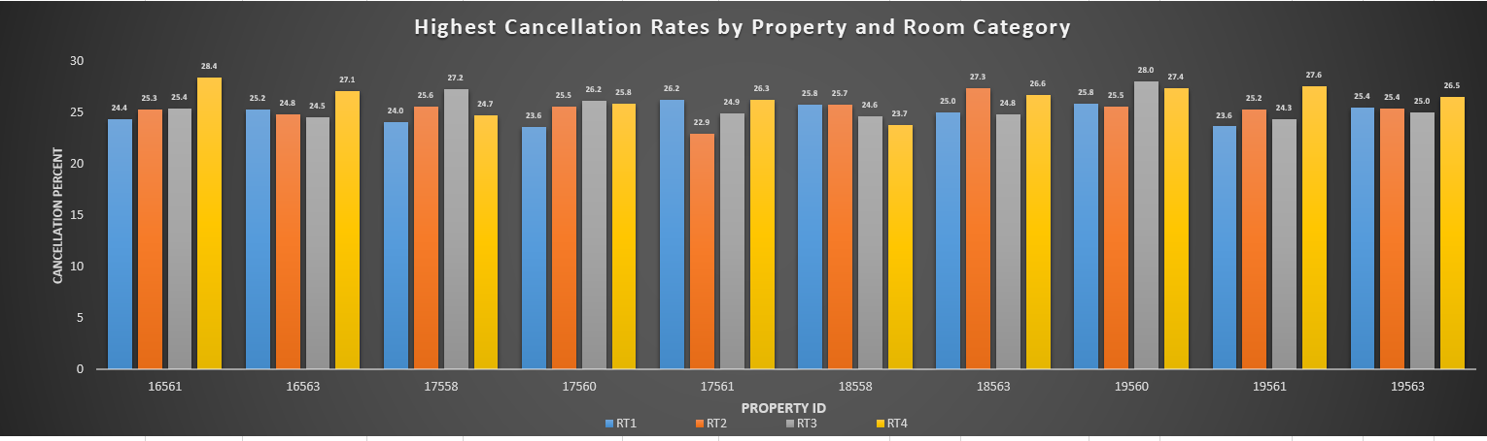
6.Highest Cancellation Rates by Property ID and Room Category
Insight → Cancellation % is consistently high (22–28%), with some properties/room categories showing extreme values (RT3/RT4 in 17562 & 19560).
Recommendation → Tighten cancellation policies, promote prepaid/loyalty bookings, and investigate high-risk room types to minimize revenue loss.

Slide 31
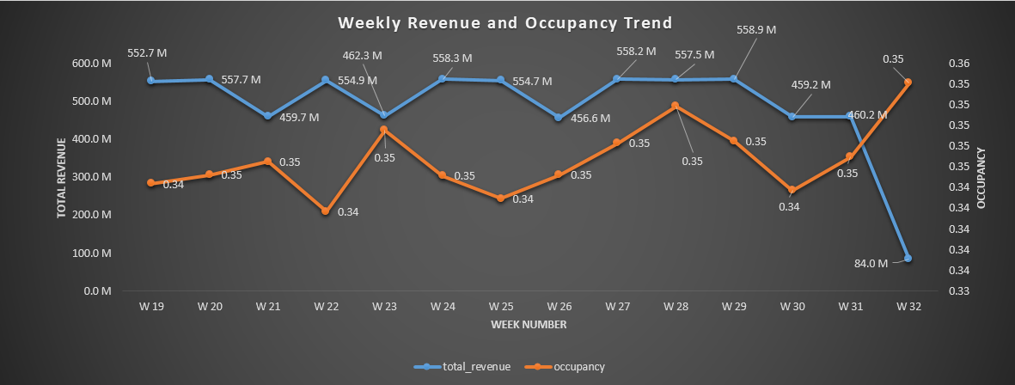
7.Weekly Revenue and Occupancy Trend
Insight → Revenue remained stable (~480M–590M) with stagnant occupancy (0.34–0.35), showing a weak link between pricing and room fills. A sharp drop to 88.8M in W32 highlights either bulk cancellations, system issues, or market disruption. Competitors likely captured demand with more agile pricing, leaving Atlas Grands vulnerable.
Recommendation → Adopt dynamic pricing and promotional strategies to improve occupancy beyond 0.35 while safeguarding revenue. Investigate the W32 anomaly immediately and strengthen corporate tie-ups and loyalty programs. Benchmark competitor strategies to regain market share and optimize revenue efficiency across properties.

Slide 32
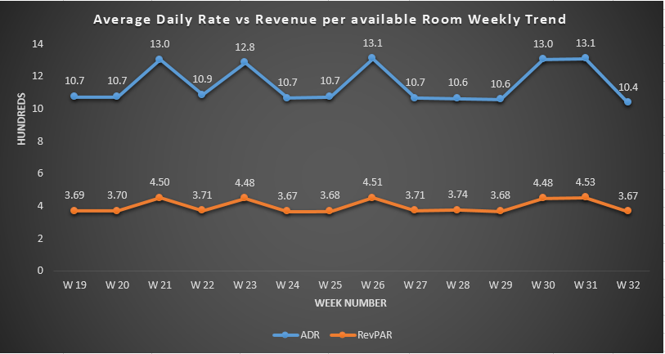
8.Average Daily Rate vs Revenue per Available Room Weekly Trend
• Insight → ADR remained steady (11–14), but RevPAR stayed much lower (3.9–4.8), indicating weak occupancy. High ADR peaks (W21, W26, W30–31) did not translate into proportional revenue, showing underutilization of rooms.
• Recommendation → Implement dynamic pricing and targeted promotions to boost occupancy. Leverage loyalty programs, corporate tie-ups, and bundled offers while improving guest experience to enhance RevPAR and long-term profitability.

Slide 33
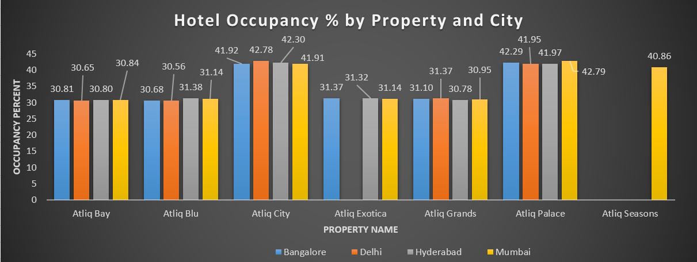
9.Hotel Occupancy % by Property and City
Insights: Atlas Grands hotels are operating at a low occupancy rate of ~30–32% across most properties, indicating underutilization of capacity. Only a few properties like Atliq Palace, Atliq City, and Atliq Seasons show relatively better occupancy (~41–43%), suggesting stronger demand or better positioning in select markets. Larger properties with higher capacity are not translating into proportionate bookings, pointing to pricing or demand-generation gaps.
Recommendations: To regain market share, Atlas Grands should adopt dynamic pricing and targeted marketing campaigns, especially for underperforming properties. Best practices from high-performing hotels should be replicated across locations, while partnerships with OTAs and direct booking platforms can help improve visibility. Establishing regular data-driven tracking of occupancy and revenue will enable proactive decision-making and enhance overall performance.

Slide 34
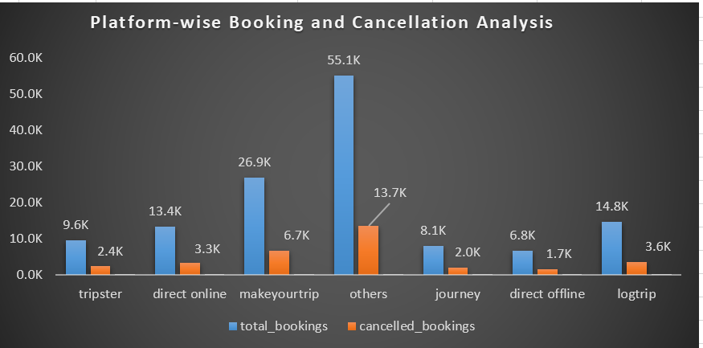
10.Platform-wise Booking and Cancellation Analysis
Insights: Most bookings come from the “Others” category and MakeYourTrip, but these channels also show the highest cancellations, reducing revenue realization. Direct channels (online and offline) have lower booking volumes but relatively lower cancellation rates, indicating more reliable customers.
Recommendations: Focus on strengthening direct booking channels through promotions and loyalty programs to improve profitability. Work with high-cancellation platforms to reduce no-shows (e.g., stricter cancellation policies or flexible pricing). Diversifying reliance away from “Others” and incentivizing direct bookings can improve both occupancy stability and revenue.

Slide 35
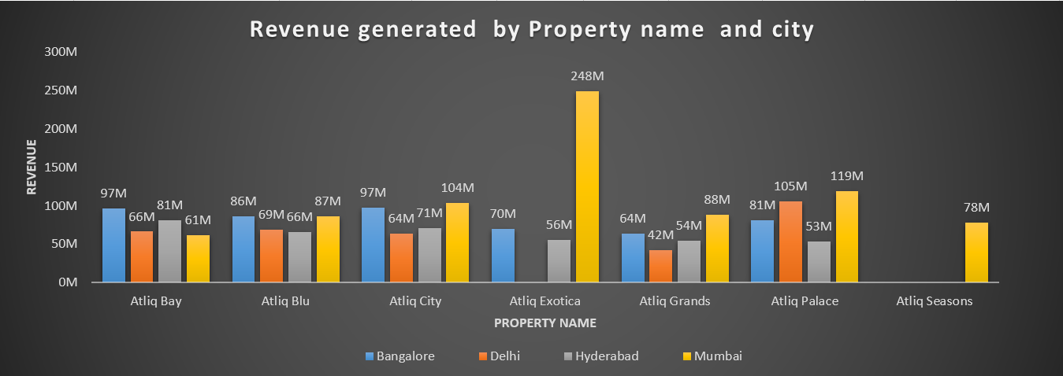
11.Revenue generated & realized by Property name and city
Insights: The data shows that while Atliq properties generate strong revenues across cities, the revenue realized is consistently 10–15% lower than generated, pointing to losses from cancellations or no-shows. Mumbai properties lead in overall revenue, especially Atliq Exotica, but still face high leakage. Delhi properties show larger gaps, suggesting operational or demand issues, while Bangalore and Hyderabad perform more steadily but with moderate revenue shortfalls.

Slide 36
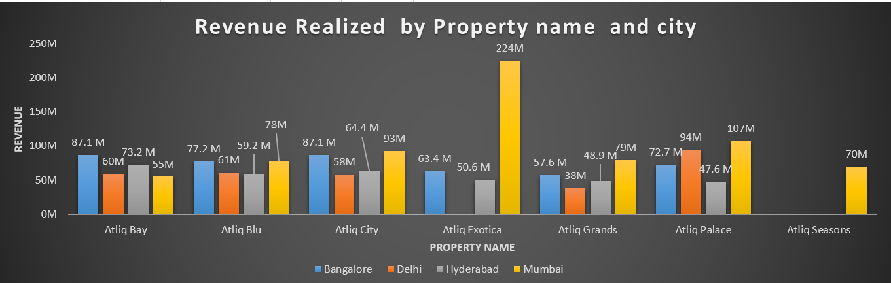
Recommendations: Focus on improving revenue realization by reducing cancellations (stricter booking policies, better customer engagement), optimize pricing and promotions for Delhi properties, and analyze operational gaps in high-revenue properties like Atliq Exotica and Atliq Palace. Strengthening customer loyalty programs and enhancing demand forecasting can also minimize leakage and boost profitability.

Slide 37
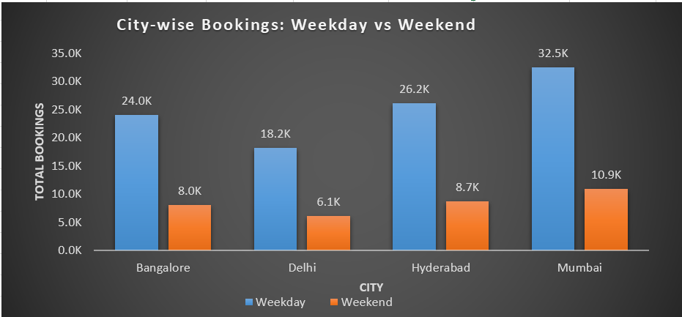
12.City-wise Bookings: Weekday vs Weekend
Insights: The data shows that weekday bookings are significantly higher than weekend bookings across all cities, with Mumbai leading in overall volume followed by Hyderabad, Bangalore, and Delhi. This indicates stronger demand during business days, likely driven by corporate and business travelers.
Recommendation: Hotels can introduce targeted weekend offers, leisure packages, and family-oriented promotions to boost weekend occupancy, while maintaining premium pricing for weekdays to maximize revenue from business travelers.

Slide 38
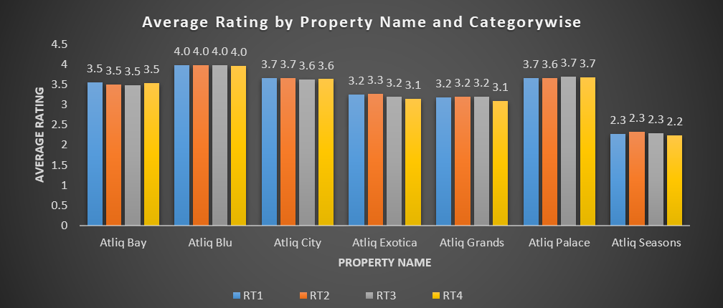
13.Average Rating by Property Name and Categorywise
Insights: The chart shows that Atliq Blu consistently has the highest ratings (around 4.0) across all room categories, while Atliq Seasons records the lowest (around 2.2–2.3), signaling a need for major service improvement. Other properties like Atliq Bay, Atliq City, and Atliq Palace perform moderately well (3.5–3.7), whereas Atliq Exotica and Atliq Grands show only average satisfaction (around 3.1–3.2).
Recommendation: Focus on improving guest experience and service quality at Atliq Seasons, since low ratings can hurt brand image. For mid-performing properties, targeted improvements in amenities, cleanliness, and customer engagement could help push ratings closer to Atliq Blu’s benchmark.

Slide 39
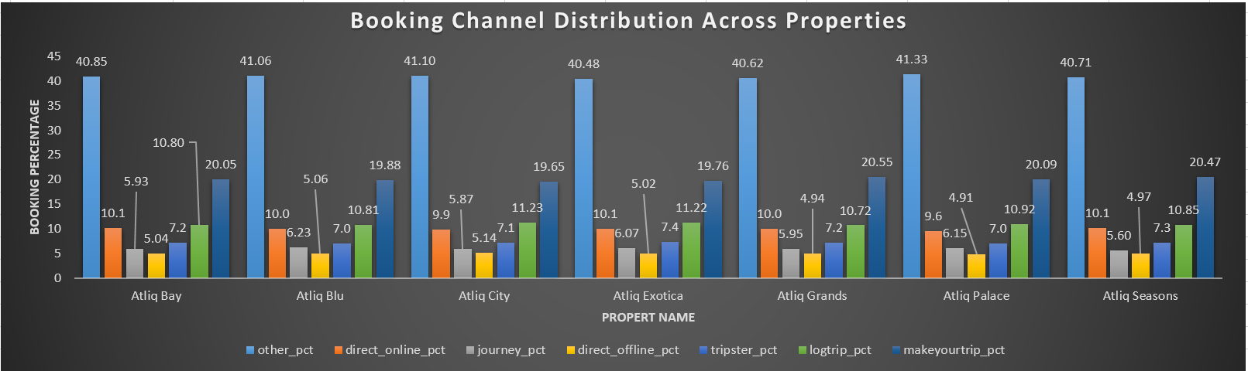
14.Booking Channel Distribution Across Properties
Insights: The distribution of bookings across channels is fairly consistent across properties, with Other contributing the highest
percentage (~40–41%) and Direct Online, LogTrip, and MakeYourTrip showing significant shares. Offline channels and travel agencies
like Journey and Direct Offline have comparatively lower contributions.
Recommendations: Focus on strengthening high-performing digital channels (Direct Online, LogTrip, MakeYourTrip) while exploring
strategies to boost lower-performing channels, such as targeted promotions through travel agencies or offline partnerships, to diversify
booking sources and reduce dependency on a single channel.

Slide 40
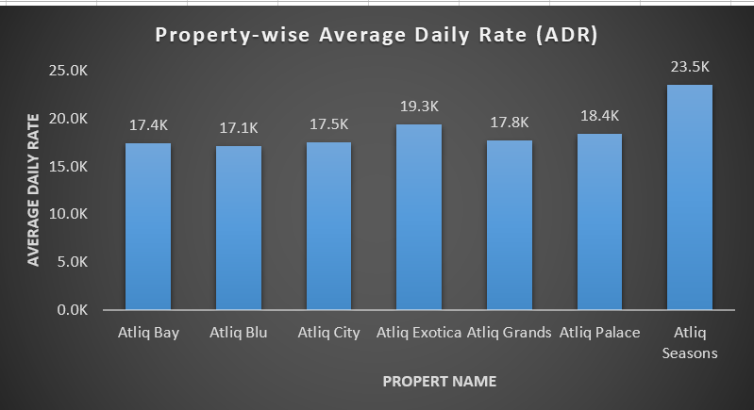
15.Property-wise Average Daily Rate (ADR)
Insights: The chart highlights significant variation in Average Daily Rate (ADR) across properties, with Atliq Seasons commanding the highest rates, followed by Atliq Exotica and Atliq Palace, while properties like Atliq Blu and Atliq City operate at relatively lower ADR levels.
Recommendation: Focus on leveraging premium properties with higher ADR through targeted marketing and upselling, while reviewing pricing strategies for lower-ADR properties to ensure competitiveness and profitability without compromising occupancy.

Slide 41
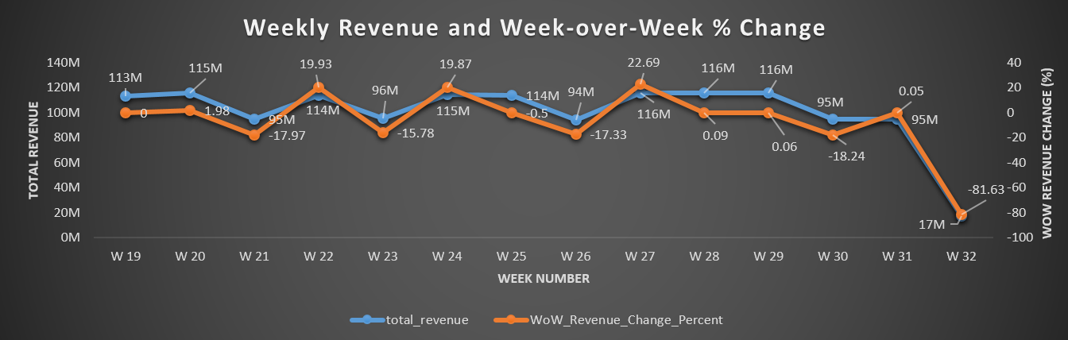
16.Weekly Revenue and Week-over-Week % Change
Insights: The weekly trend shows fluctuating revenue with sharp declines in weeks 21, 26, 30, and a steep drop in week 32, indicating possible seasonality or operational issues. While revenue recovered strongly after some dips, the volatility highlights inconsistency in performance.
Recommendation: Focus on analyzing reasons for sudden drops (e.g., cancellations, reduced demand, or pricing strategy) and implement targeted promotions or operational improvements during low-performing weeks to stabilize revenue growth.

Slide 42

Dashboard

Slide 43
Dashboard Menu
Theme | Objective | Primary Stake Holder | Daily users
Booking Overview | Show total bookings & revenue trends | CEO, Strategy Head | Leadership Team
Hotel Performance | Compare hotels by occupancy & ratings | Regional Managers | Hotel Managers, Analysts
Booking Platform Optimization | Evaluate revenue and booking trends across platforms (Direct Online, Direct Offline, Journey, Tripster, Logtrip, Makeyourtrip, Others) to refine channel strategy. | Head of Digital Sales & Marketing / Chief Commercial Officer (CCO) | E-commerce Team, Distribution Analysts, Revenue Managers

Slide 44
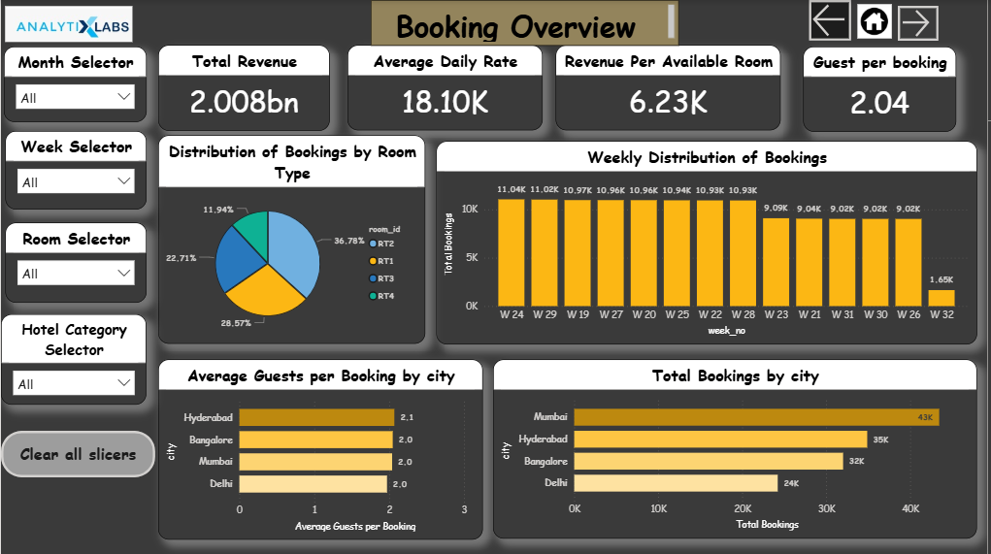

Slide 45
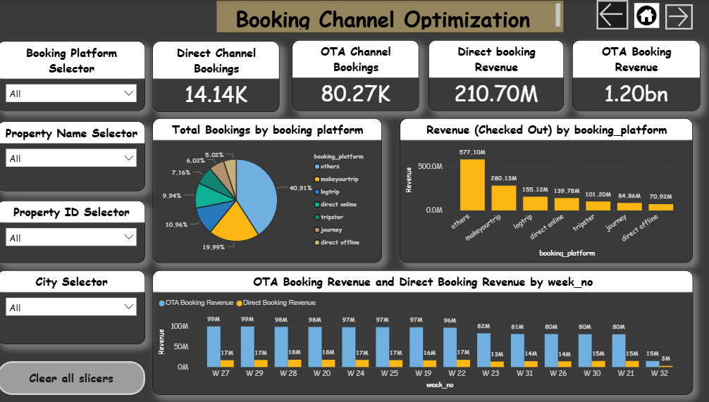

Slide 46
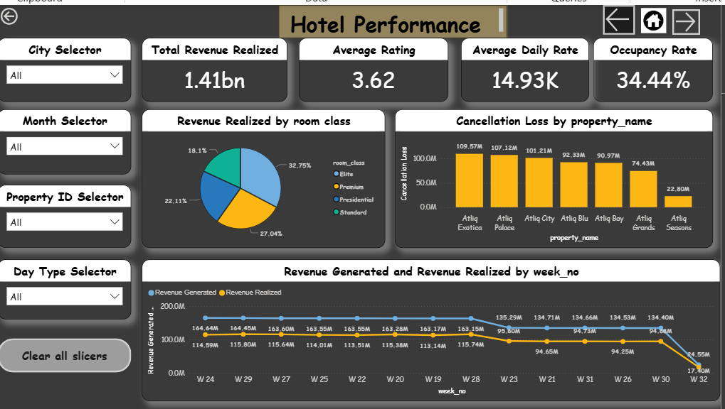

Slide 47

Recommendation

Slide 48
1. Booking Overview
Use booking dashboards to detect demand patterns and shift marketing spend towards high-performing channels.
Launch early-bird discounts and weekend packages to capture lost demand and counter competition.
Monitor booking trends to forecast demand spikes and prevent last-minute over/under-staffing.
2. Hotel Performance
Compare hotels on occupancy & ratings to identify underperforming properties → prioritize service upgrades.
Benchmark successful hotels and replicate their best practices (pricing, guest services) across low performers.
Use occupancy analysis to decide where to expand capacity vs where to cut costs.
3. Booking Platform Optimization Dashboard
Negotiate better commission terms with high-volume OTAs.
Invest more in digital ads to boost direct online bookings.
Phase out low-performing platforms that add cost but minimal bookings.

Slide 49
THANK YOU!

